Slide 1
Cloud Architect Nanodegree Program
P2: Cost Optimization and Monitoring for Your Company
Dhruv Kinger
Udacity Mentor| SWE at ThrivePass

Slide 2
Today’s Agenda
Ice breaker activity
Project walkthrough
Project Tips & Tricks
QA

Slide 3
Ice Breaker : Let’s have fun 🤩😎 What crazy activities do you dream of trying someday?

Slide 4
Project Walkthrough

Slide 5
Project Summary
Company "X," which has offices in both the US East Coast and US West Coast. They currently host all their data and applications in a single East coast data center and are constantly worried about both cost and resiliency. In this project, you are given a series of steps to complete to compare on-prem costs to Azure-based costs and to configure resources within Azure.
You will submit screenshots and short explanations of the importance of the tools within Azure and how you can improvise their current architecture.

Slide 6
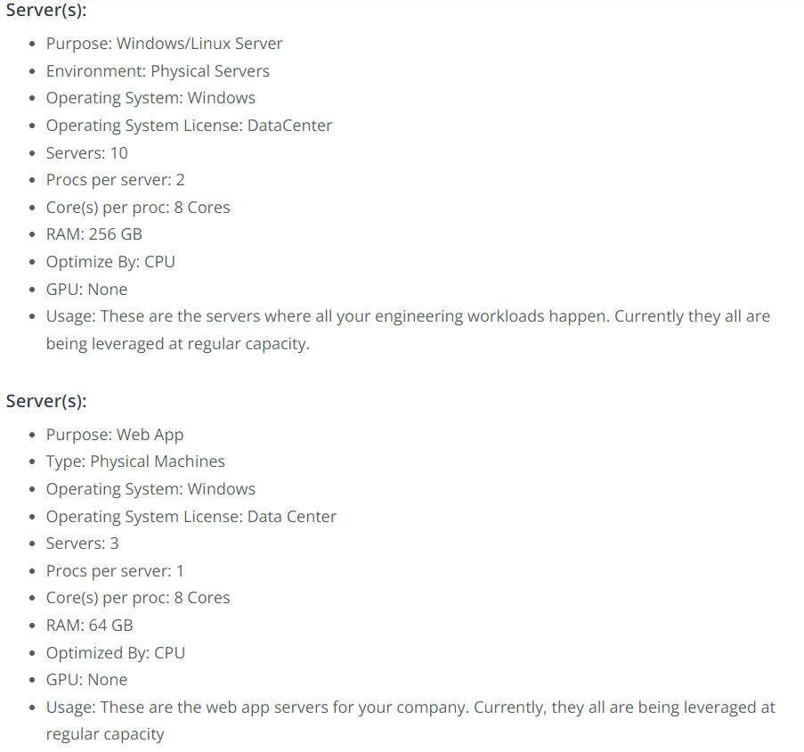
On Prem Servers

Slide 7
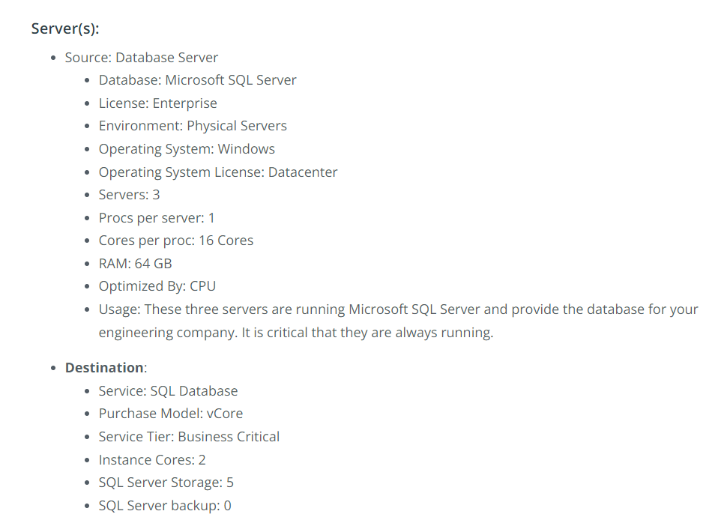
On Prem Servers

Slide 8
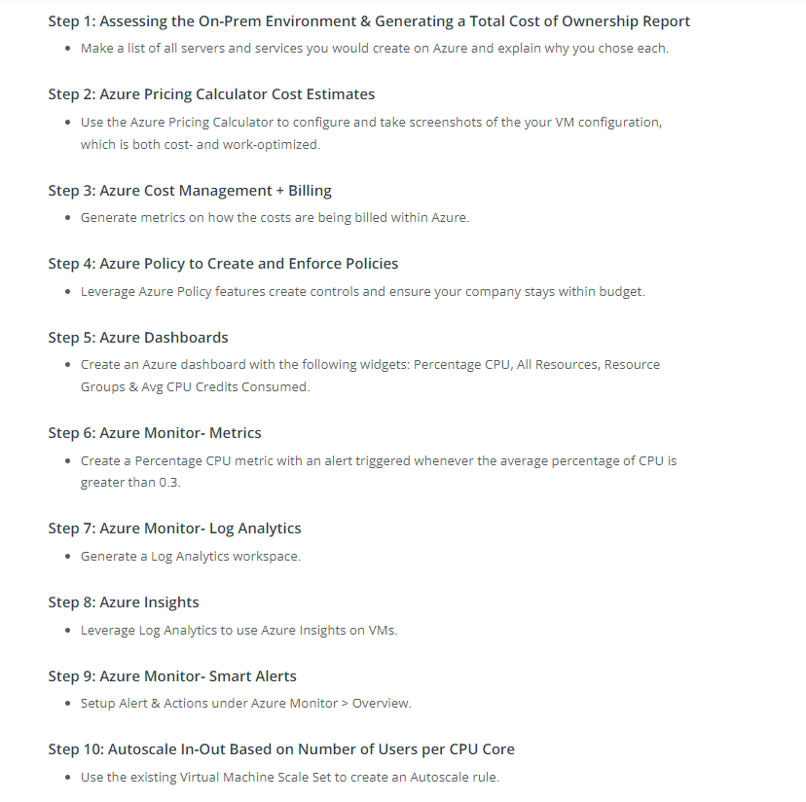
Expectations

Slide 9
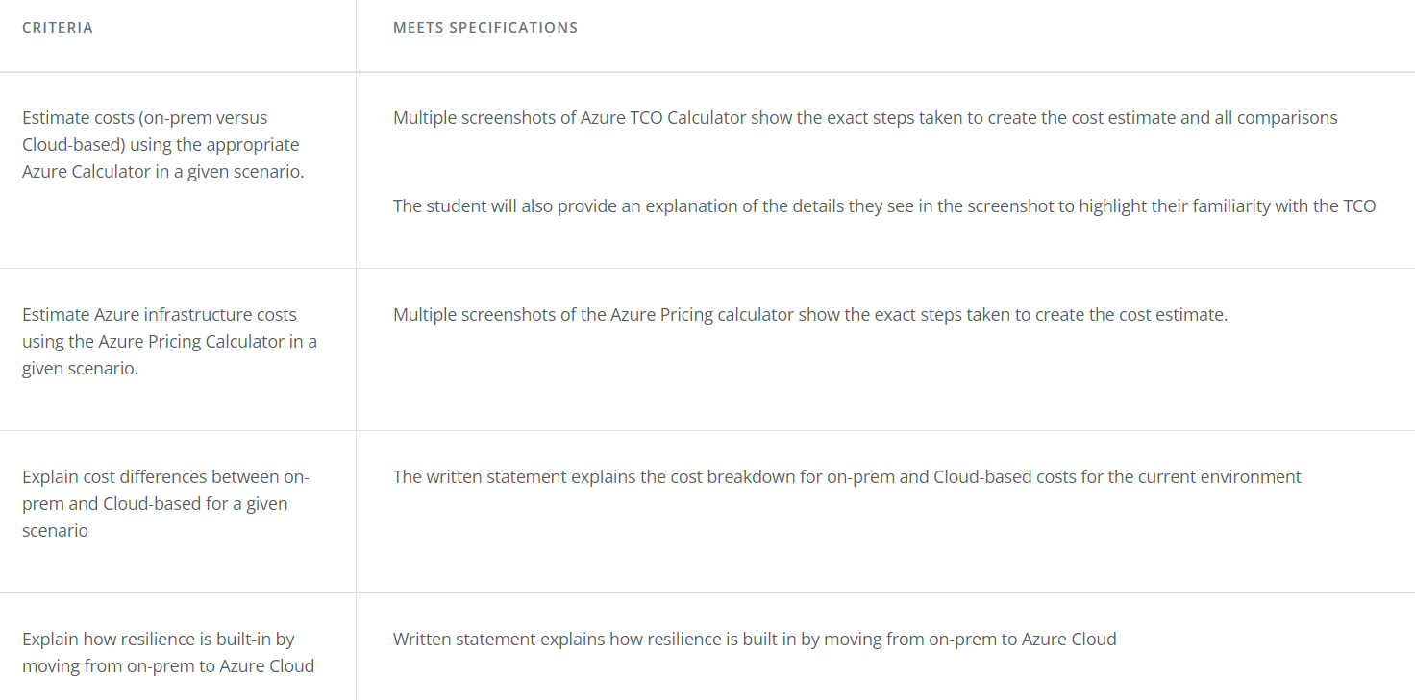
Rubric Points

Slide 10
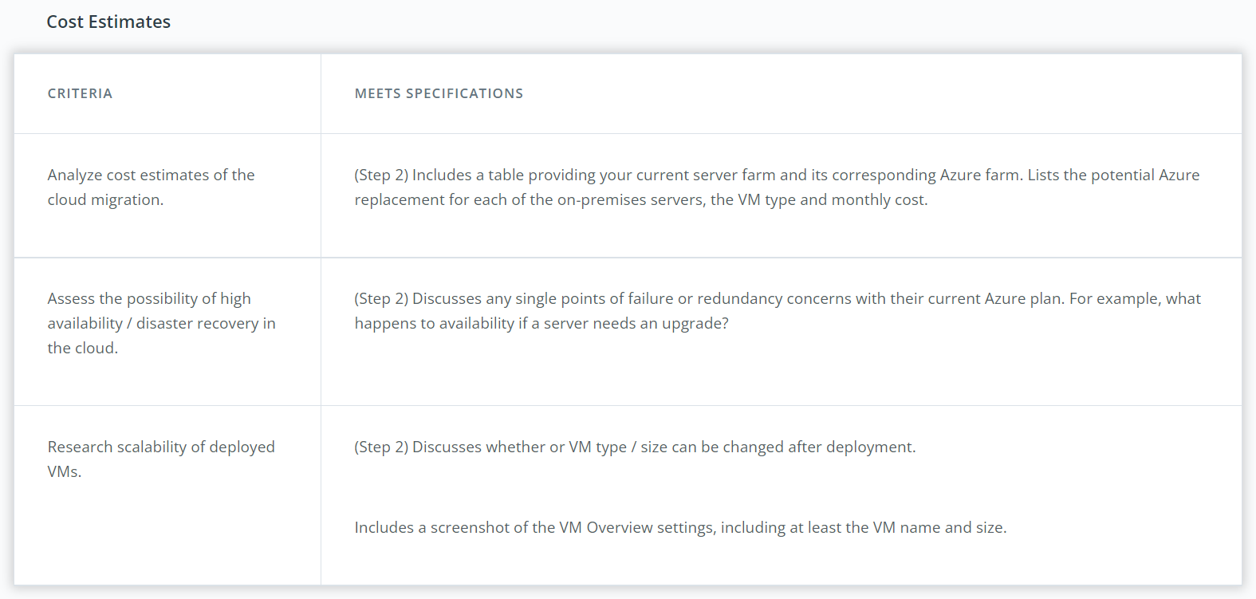
Rubric Points continued

Slide 11
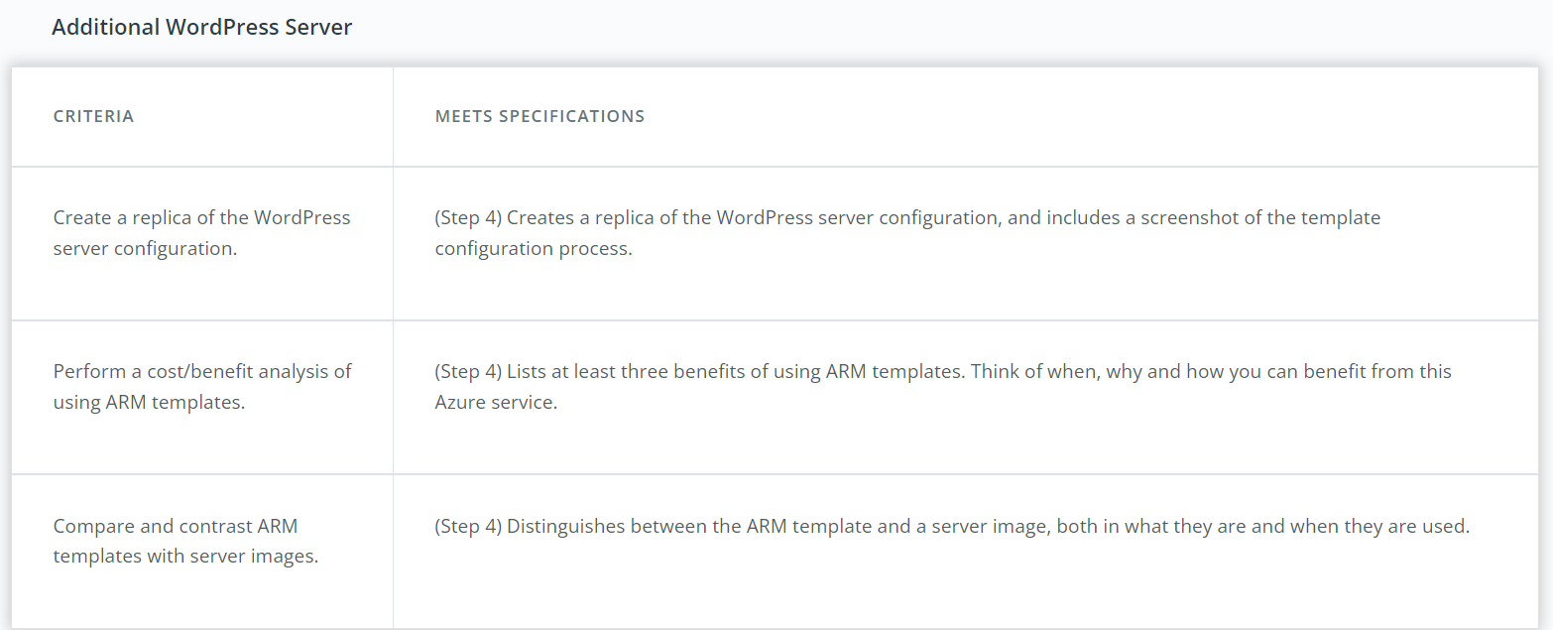
Rubric Points continued

Slide 12
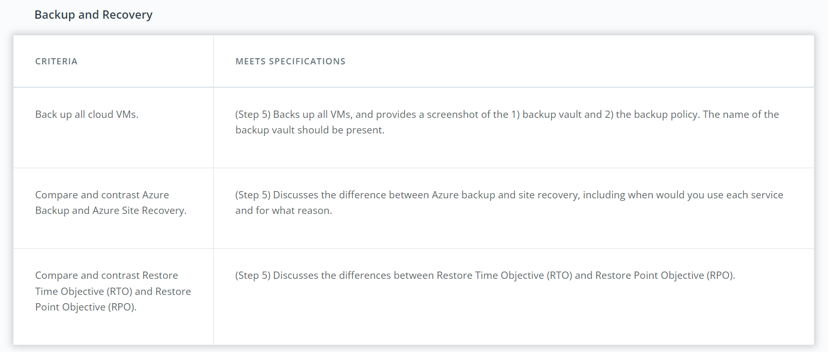
Rubric Points continued

Slide 13
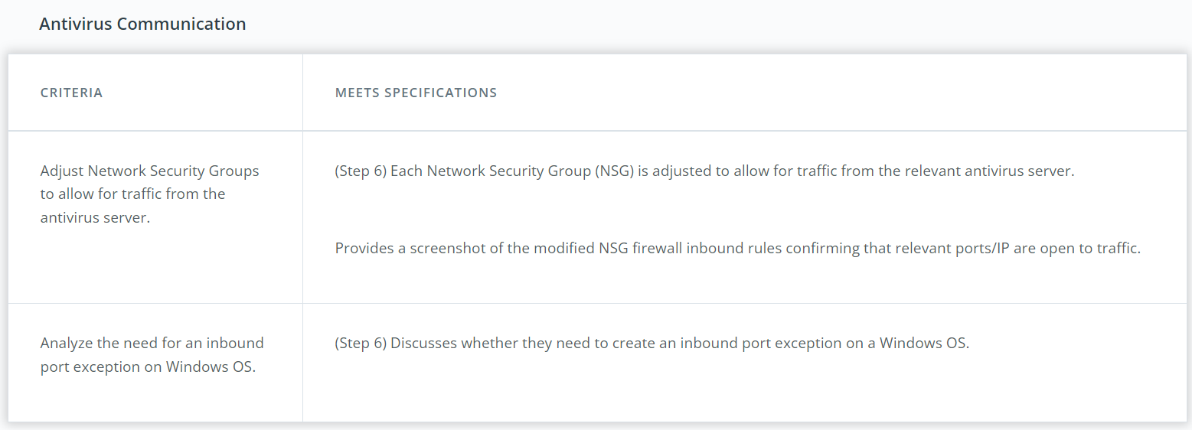
Rubric Points continued

Slide 14
Benefits of Moving to Azure
Data Security : Security in Microsoft Azure is built in at different levels and can be customized as per customer requirements. The security of data stored in Azure is managed by encrypting the data at rest through various mechanisms.
Data Resiliency (elasticity) : When you use Azure cloud storage, your data is physically stored in secure data centers operated by Microsoft. For example, the disks of the virtual machines that you use for your virtual machine are stored as page blobs in Azure storage.
Single-Pane Operations : Last but not the least, it is important to have a single pane of management to gain visibility and insights into what is happening with your infrastructure, & Azure completely fits into this.

Slide 15
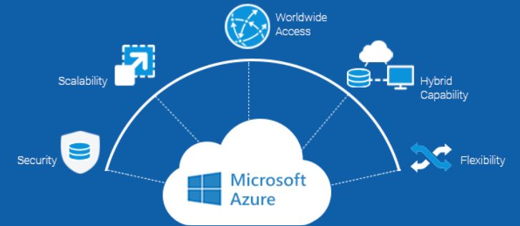
Let’s discuss

Slide 16
Benefits of ARM Templates
Create any Azure resource: We can immediately use new Azure services and features in templates. As soon as a resource provider introduces new resources, we can deploy those resources through templates.
Built-in validation: Our template is deployed only after passing validation. Resource Manager checks the template before starting the deployment to make sure the deployment will succeed.
Complex Deployments will be made easier and Reduction in User Error.
CI/CD integration: We can integrate templates in continuous integration and continuous deployment (CI/CD) tools, which can automate release pipelines for fast and reliable application and infrastructure updates.

Slide 17
Tips & Tricks
Use of Arm Template to deploy VM as you have done in Lab Exercise Deploy a Storage Account using an ARM Template.
Many Students keep on asking that whether they must deploy On Prem Servers ? Ask this Question from yourself.
Think of High Availability for the Designed Architecture in Azure ? Do you think is it well designed ? Even this is asked in Project Template.

Slide 18
Additional Resources
How to Setup a VPN ?
Want to read some of mine Azure Related Blogs ?
Thinking to get Microsoft Certified ? Here are some of the Paths.
Want to read Some More benefits of Arm Templates ? Do give a Read.

Slide 19
🤩 Yeah, it’s QA Time 🤩

Slide 20
🙏 Thanks 🙏
Want to Connect ?
Twitter Handle: @KingerDhruv
LinkedIn: https://linkedin.com/in/dhruv-kinger
GitHub: https://github.com/DhruvKinger

